Slide 1

Chapter 13
Operator Overloading

Slide 2
Objectives
To define the Rational class to represent rational numbers (§13.2).
To understand in general how an operator can be overloaded in C++ (§13.3).
To know how to overload the relational operators and arithmetic operators (§13.3).
To know how to overload the shorthand operators (§13.4).
To know how to overload the array subscript operator [] (§13.5).
To know how to overload the unary operators (§13.6).
To know how to overload the prefix and postfix ++ and –- operators (§13.7).
To know how to overload the stream insertion and extraction operators << and >> (§13.8).
To define operator functions to perform object conversion (§13.9).
To overload the = operator to perform a deep copy (§13.11).

Slide 3
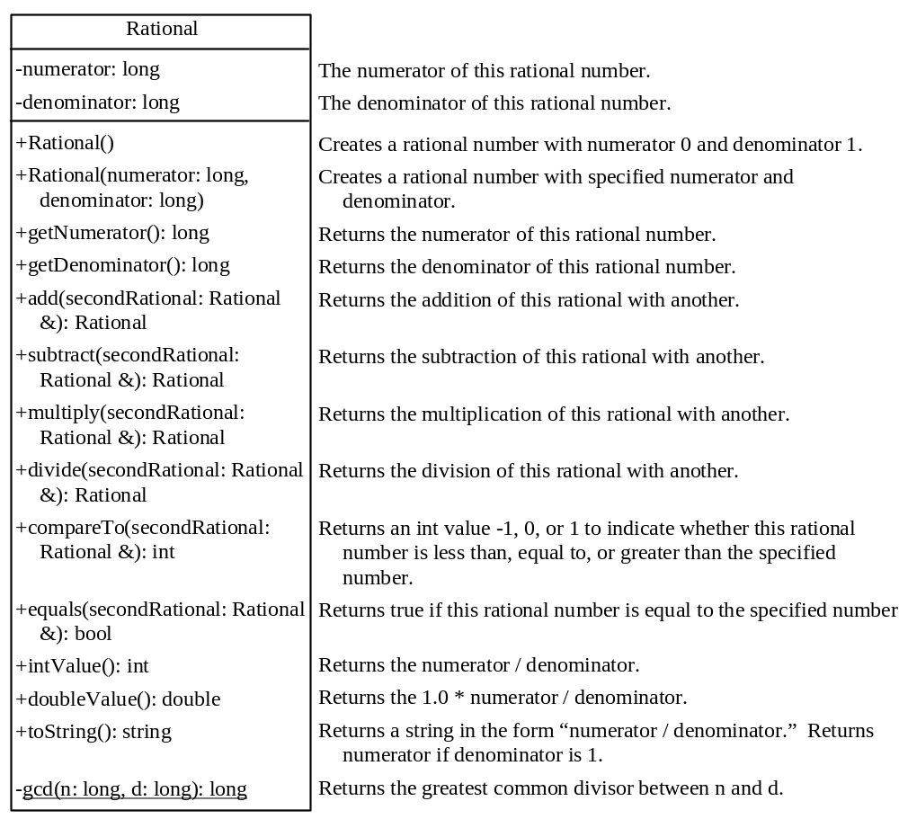
The Rational Class
Rational.h
Rational.cpp
TestRationalClass.cpp
Run

Slide 4
Operator Functions
bool Rational::operator(Rational &secondRational)
{
if (this->compareTo(secondRational) < 0)
return true;
else
return false;
}

Slide 5
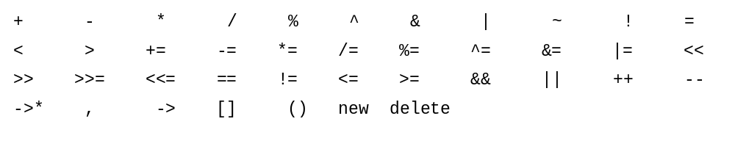
Overloadable Operators

Slide 6

Operators That Cannot Be Overloaded

Slide 7
Precedence and Associativity
C++ defines the operator precedence and associativity (see §3.12, “Operator Precedence and Associativity.”) You cannot change the operator precedence and associativity by overloading.

Slide 8
+ Function Operator
Rational Rational::operator+(Rational
&secondRational)
{
return this->add(secondRational);
}

Slide 9
Overloading the Shorthand Operators
C++ has shorthand operators +=, -=, *=, and /= for adding, subtracting, multiplying, and dividing a value in a variable. You can overload these operators in the Rational class.
Rational Rational::operator+=(Rational &secondRational)
{
*this = this->add(secondRational);
return (*this);
}

Slide 10
Overloading the Shorthand Operators
Rational r1(2, 4);
Rational r2 = r1 += Rational(2, 3);
cout << "r1 is " << r1.toString() << endl;
cout << "r2 is " << r2.toString() << endl;

Slide 11
Overloading the [] Operators
In C++, the array subscript [] is an operator. You can overload this operator to access the contents of the object using the array-like syntax if desirable. For example, you may wish to access the numerator and denominator using r[0] and r[1].

Slide 12
Overloading the [] Operators
long Rational::operator[](const int &index)
{
if (index == 0)
return numerator;
else if (index == 1)
return denominator;
else
{
cout << "subscript error" << endl;
exit(0);
}
}

Slide 13
[] accessor and mutator
The [] operator functions as both accessor and mutator. For example, you use r2[0] as an accessor to retrieve the numerator in an expression, and use r2[0] = value as a mutator. After adding this operator to the Rational class, the Rational class is mutable.

Slide 14
Overloading the Unary Operators
The + and - are unary operators. They can be overloaded too. Since the unary operator operates on one operand that is the calling object itself, the unary function operator has no parameters.
Rational Rational::operator-()
{
numerator *= -1;
return *this;
}

Slide 15
Overloading the ++ and -- Operators
The ++ and -- operators may be prefix or postfix. The prefix ++var or --var first adds or subtracts 1 from the variable and then evaluates to the new value in the var. The postfix var++ or var-- adds or subtracts 1 from the variable, but evaluates to the old value in the var.
If the ++ and -- are implemented correctly, the following code

Slide 16
Overloading the ++ and – Operators, cont.
Rational Rational::operator++()
{
numerator += denominator;
return *this;
}
Rational Rational::operator++(int dummy)
{
Rational temp(numerator, denominator);
numerator += denominator;
return temp;
}

Slide 17
Overloading the << and >> Operators
C++ allows you to overload the stream insertion operator (<<) for sending an object to cout and overload the stream extraction operator (>>) for reading values from cin. Overloading these two operators is different from other operators you have seen in this chapter. Since the first parameter of the << (>>) operator is an instance of ostream (istream), these two operators are defined in the ostream and istream classes, not in the Rational class.

Slide 18
Overloading the << and >> Operators
ostream &operator<<(ostream &stream, Rational &rational)
{
stream << rational.numerator << " / " << rational.denominator;
return stream;
}

Slide 19
Overloading the << and >> Operators
istream &operator>>(istream &stream, Rational &rational)
{
cout << "Enter numerator: ";
stream >> rational.numerator;
cout << "Enter denominator: ";
stream >> rational[1];
return stream;
}

Slide 20
Object Conversion
You can add an int value with a double value such as
4 + 5.5
In this case, C++ performs automatic type conversion to convert an int value 4 to a double value 4.0.
Can you add a rational number with an int or a double value? Yes. You have to define a function operator to convert an object into int or double. Here is the implementation of the function to convert a Rational object to a double value.

Slide 21
Object Conversion
Rational::operator double()
{
return doubleValue();
}
Rational r1(1, 4);
double d = r1 + 5.1;
cout << "r1 + 5.1 is " << d << endl;

Slide 22
The New Rational Class
The preceding sections introduced how to overload function operators. You are ready to give a new Rational class with all appropriate function operators. Listings 13.4 and 13.5 show the new Rational.h and Rational.cpp.
NewRational.h
NewRational. cpp
TestNewRationalClass
Run

Slide 23
Overloading the = Operators
By default, the = operator performs a memberwise copy from one object to the other. For example, the following code copies r2 to r1.
Rational r1(1, 2);
Rational r2(4, 5);
r1 = r2;
cout << "r1 is " << r1.toString() << endl;
cout << "r2 is " << r2.toString() << endl;
DefaultAssignmentDemo
Run

Slide 24
Overloading the = Operators
To change the way the default assignment operator = works, you need to overload the = operator. In the Person.h file, define
const Person operator=(const Person &person)
Why the return type is Person not void? C++ allows multiple assignments such as:
person1 = person2 = person3;
In this statement, person3 is copied to person2, and then returns person2, and then person2 is copied to person1. So the = operator must have a valid return value type.

